Slide 1

My Recipe Finder
ITC209 Assignment 5 App Presentation
Michelle Vinall
11591510

Slide 2

Introduction
My name is Michelle and I’m doing my second year of a Bachelor of Computer Science.
I started doing this degree to better my prospects of work and I also enjoy working with computers. I would like to get work as a programmer or work with websites in design and programming. I have previously completed a Diploma in Software Development and have been working with code for approximately 3 years.

Slide 3
App Overview
My application is a recipe searching, storing and viewing app.
As a busy mother of five I know what it can be like finding and preparing meals for everyone, this app helps those with a busy lifestyle to quickly search thousands of recipes all in the one place.
I have many a time had to come to my computer to look up recipe ideas but with this app if you’ve got your phone and a internet connection you can look at a time convenient to you

Slide 4
App Overview
The target market of my app are busy mothers/fathers/professionals aged between 25-45 who cook at home.
There are a few competing apps out there like Tasty Recipes which gives you a daily recipe and has video tutorials good if you have the time to watch them.
Allrecipes Dinner Spinner also has videos on cooking searchable recipes, recipe saving, sharing, and a personalised feed.

Slide 5
App Functionality (Implemented and Intended)
The final functionality of my app is the ability to search for recipes from an online database.
Save your own recipes to a cookbook which saves to a local Sqlite database for easy retrieval.
Delete them from the database.
Update them.
View the recipes.
I had intended to implement image saving and retrieving with no luck.

Slide 6
Tools and Platform used
I have chosen the Android platform
as it is open source and one of the most popular platforms available, it holds the majority of the market share.
You can port java developed apps to other mobile operating systems as well which means better availability
You also have google play store available to release apps for downloading and installation.

Slide 7
Tools and Platform used
Tools used include:
Android Studio – is a all in one IDE, that you can instantly build and run your apps on, it has a host of tools and plugins available, and an emulator available for testing, which is also enhanced with the GBU debugger.
The use of libraries can readily enhance your app my app did not require any special ones to be used only the basic java libraries normally required.
No plugins were required for my app either although there are many available.

Slide 8
Tools and Platform used
Requirements-
Minimum SDK: API 16: Android 4.1 (Jelly Bean). This allows my application to run on approximately 99.2% of all devices that are active Google Play.
I ran and tested it on my own phone which is an Aalcatel_5045A Android 6.0 API: 23 as well as an emulator Android 5.0 API: 21
Device Permissions-
android.permission.INTERNET – allows users to access the internet.
android.permission.READ_EXTERNAL_STORAGE - allows the app permission to read the database in storage.
android.permission.WRITE_EXTERNAL_STORAGE - allows the app permission to write to the database in storage.

Slide 9
Techniques and Challenges
The major challenge found was getting every thing working in the Fragments instead of activities using MainActivity.this or even “this” you have to use inbuilt methods like getActivity() or getContext().
I also had troubles getting my database to retrieve items and display them in a custom listView.
Once I got my database doing what it was supposed to, I had all but given up using the tabbed activity, I decided to give it one more try because it is much easier to navigate and looks tidier. I transferred my code to the tabbed layout and with a few minor changes I finally got it working.

Slide 10
Intended Improvements
To implement the ability to add images to the database from either gallery choose or camera choose, which I had planned on doing.
Add categories to the data saved such as main meals, desserts etc.
Improve the UI visually.
I think the basic code and variables need tidying up also.

Slide 11
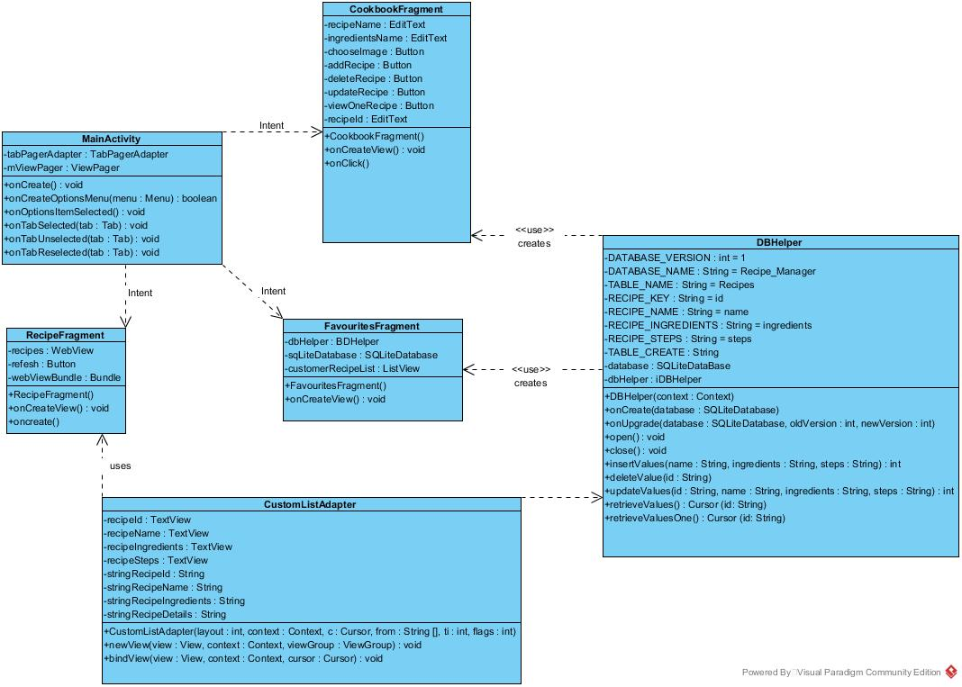
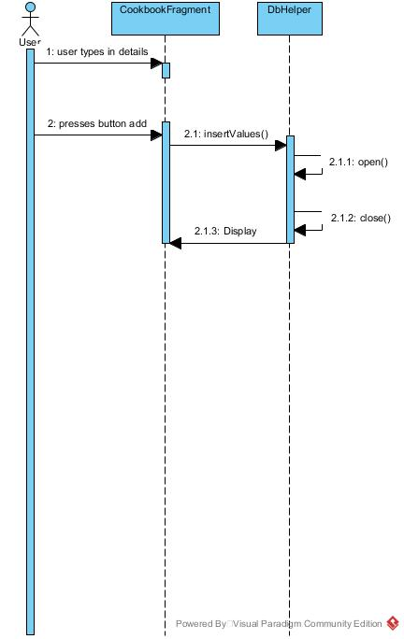
Architecture of the App

Slide 12
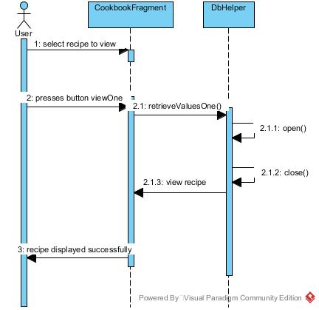
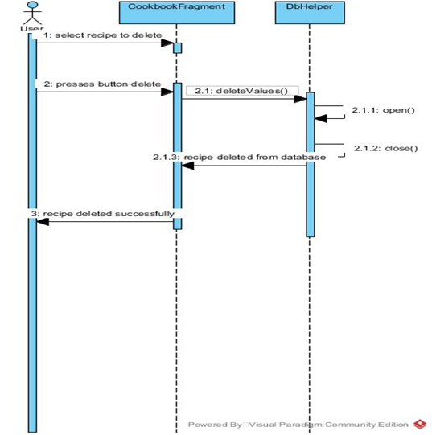
Architecture of the App (cont.)

Slide 13
Use Case 1
Use case 1 is the searching of recipes
Starts with the user opening the app
System loads Food2Fork
Then the user can interact with the webview.
@Override public View onCreateView(LayoutInflater inflater, ViewGroup container, Bundle savedInstanceState) { View view = inflater.inflate(R.layout.fragment_recipe, container, false); recipes = (WebView) view.findViewById(R.id.webView); if (recipes != null) { recipes.setWebViewClient(new WebViewClient()); if (webViewBundle == null || webViewBundle.isEmpty()) { recipes.loadUrl("http://food2fork.com"); } else { recipes.restoreState(webViewBundle); webViewBundle.clear(); } } WebSettings webSettings = recipes.getSettings(); webSettings.setJavaScriptEnabled(true);

Slide 14
Use Case 2
dbHelper = new DbHelper(getActivity()); addRecipe = (Button) view.findViewById(R.id.add); addRecipe.setOnClickListener(new View.OnClickListener() { public void onClick(View view) { dbHelper.open(); long insert = dbHelper.insertValues( recipeId.getText().toString(), recipeName.getText().toString(), ingredientName.getText().toString(), steps.getText().toString()); dbHelper.close(); if (insert > 0) { Toast.makeText(getActivity().getApplicationContext(), "Recipe " + insert + " inserted successfully", Toast.LENGTH_LONG).show(); } else { Toast.makeText(getActivity().getApplicationContext(), "No records were inserted", Toast.LENGTH_LONG).show(); } recipeId.setText(""); recipeName.setText(""); ingredientName.setText(""); steps.setText(""); } });
Use case 2 is adding recipes to the data base
User needs to navigate to the cookbook page
Adds in details
Then presses add button
Receives toast saying successfully inserted

Slide 15
Use Case 3
Use case 3 is updating recipes to the data base
User needs to navigate to the cookbook page
Chooses recipe to update and adds new detail
Then presses update button
Receives toast saying successfully updated
public int updateValues(String id, String name, String ingredients, String step) { ContentValues contentValues = new ContentValues(); contentValues.put(RECIPE_NAME, name); contentValues.put(RECIPE_INGREDIENTS, ingredients); contentValues.put(RECIPE_STEPS, step); int update = database.update(TABLE_NAME, contentValues, COLUMN_ID + "=" + id, null); return update; }

Slide 16
Use Case 4
viewOne = (Button) view.findViewById(R.id.viewOne); viewOne.setOnClickListener(new View.OnClickListener() { public void onClick(View view) { dbHelper.open(); Cursor cursor = dbHelper.retrieveValuesOne(recipeId.getText().toString()); cursor.moveToFirst(); do { String name = cursor.getString(1); String ingredients = cursor.getString(2); String steps1 = cursor.getString(3); recipeName.setText(name); ingredientName.setText(ingredients); steps.setText(steps1); } while (cursor.moveToNext()) ; cursor.close(); dbHelper.close(); } });
View One use case
User chooses Id of recipe to display
Writes it in
Recipe displays on page

Slide 17
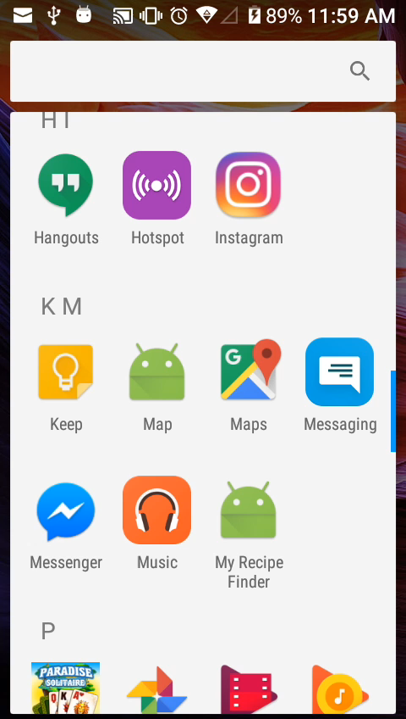
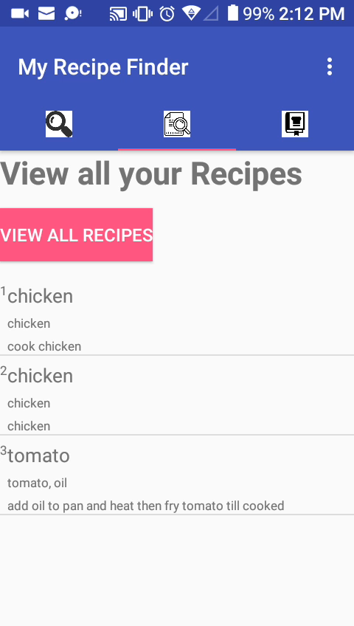
Presentation

